Slide 1
Research on Managerial Ability
2018 경제연구소 주례세미나
황인이 교수
서울대학교 경영대학
2019.10.17

Slide 2
OUTLINE
Motivation vs. Attraction/Retention
  Literature on Moral Hazard (Effort)
  Literature on Adverse Selection (Ability)
    Level of Compensation
Implication of Managerial Ability
  Sorting Managerial Ability
  Measurement of Managerial Ability
  Matching between Incentive Power and Ability
  Non-CEO Executive Ownership and CEO Ability
  Managerial Ability and Cost Decisions

Slide 3
Literature on Moral Hazard
  대리인 이론과 성과급 보상제도
    Jensen and Meckling. 1976. Theory of Firm: Managerial Behavior, Agency Costs and Ownership Structure. Journal of Financial Economics 3(4)
    Holmstrom. 1979. Moral Hazard and Observability. Bell Journal of Economics 10(1)
  성과지표의 성격
    Banker and Datar. 1989. Sensitivity, Precision, and Linear Aggregation of Signals for Performance Evaluation. Journal of Accounting Research 27(1)
    Feltham and Xie. 1994. Performance Measure Congruity and Diversity in Multi-Task Principal/Agent Relations. The Accounting Review 69(3)
  성과급의 효력 여부
    Lilienfeld-Toal and Ruenzi. 2014. CEO Ownership, Stock Market Performance, and Managerial Discretion. Journal of Finance 69(3)
    Gopalan, Milbourn, Song, & Thakor. 2014. Duration of Executive Compensation. Journal of Finance 69(6)
    Bebchuk and Fried. 2010. Paying for Long-Term Performance. University of Pennsylvania Law Review 158(7)
    Peng and Roell. 2014. Managerial Incentives and Stock Price Manipulation. Journal of Finance 69(2)
    Campbell, Galpin, and Johnson. 2016. Optimal Inside Debt Compensation and the Value of Equity and Debt. Journal of Financial Economics 119(2)

Slide 4
Frydman and Jenter. 2010. CEO Compensation.
Annual Review of Financial Economics 2(1)
Competitive Pay (optimal contracts)
Increasing demand for CEO effort or scarce managerial talent
Changes in firms’ characteristics, technologies, and product markets over the past 30 years have increased the effect of CEO effort and talent on firm value
A shift in the type of skills demanded by firms from firm-specific to general managerial skills intensifies the competition for talent and allows managers to capture a larger fraction of their firms’ rents
The correlated increases in firm value and CEO pay since the 1970s
Rent Extraction (CEO entrenchment)
Weak corporate governance resulting in inefficiently high levels of compensation
  … Dodd-Frank Pay Ratio Rule
Rent extraction survives in equilibrium because firing is costly and because a replacement
CEO can also extract rents the increasing popularity of stock options, coupled with boards’ limited understanding of option valuation, may have allowed managers to camouflage their rent extraction as efficient incentive compensation (Bebchuk and Fried. 2010)
이익조정, 자의적 성과지표/목표성과, 정보공유의 회피 등)

Slide 5
Purposes of Pay Schemes
Ford Motor Company’s 2018 proxy statement
“Compensation will be used to attract, retain, and motivate employees and to reward the achievement of business results through the delivery of competitive pay and incentive programs.”
“… the Committee believes that our equity-based incentive programs have been effective for attracting, motivating, and retaining executives, as well as incentivize executives to accomplish our strategic objectives.”

Slide 6
Purposes of Pay Schemes
 | Moral Hazard (inferring effort) | Adverse Selection (inferring ability)
Infeasibility of first best solution | Principal cannot observe agent’s effort | Principal lacks information about agent’s ability
Purpose of contract | Motivate agents to choose higher effort | Choose competent agents
Performance measures | Future performance contingent on effort | Past performance revealing ability

Slide 7
Incentive or Attraction/Retention?
Hire and retain highly able managers
Premiums in a compensation contract is used to attract or retain able manager in the executive labor market (Hayes and Schaefer 1999; Milbourn 2003; Rajgopal, Shevlin, and Zamora 2006)
There exists a tension between demand for managerial talent and concern on potential overpayment (information rent) arising from unobservable managerial ability. (Samualson Econometrica 1984; Hermanson et al. Contemporary Accounting Research 2012)

Slide 8
Netflix: Freedom and Responsibility Culture
Seven Aspects of Our Culture
Pay Top of the Market
What could person get elsewhere?
  Pay them more than anyone else likely would
What would we pay for replacement?
  Pay them as much as a replacement would cost
What would we pay to keep person?
- Pay them as much as we would pay to keep them if they had higher offer from elsewhere
* Employees can choose how much they want to link their economic destiny to Netflix success or failure by deciding how much Netflix stock or stock options they want to own. (Employees can request to trade salary for stock options.)

Slide 9
OUTLINE
Motivation vs. Attraction/Retention
  Literature on Moral Hazard (Effort)
  Literature on Adverse Selection (Ability)
    Level of Compensation
Implication of Managerial Ability
  Sorting Managerial Ability
  Measurement of Managerial Ability
  Matching between Incentive Power and Ability
  Non-CEO Executive Ownership and CEO Ability
  Managerial Ability and Cost Decisions

Slide 10
Asymmetric Information in the Labor Market
Compensation as a sorting mechanism
Lazear. 2004. Output-based pay: incentives, retention, or sorting? Research in Labor Economics
Contingent term in compensation contract can function as a sorting tool for managerial ability (high-tech industries, higher level employees)
Arya and Mittendorf. 2005. Offering stock options to gauge managerial talent. Journal of Accounting & Economics
Dutta. 2008. Managerial expertise, private information, and pay-performance sensitivity (PPS). Management Science
The optimal PPS is higher (lower) than its optimal value in a benchmark setting of symmetric information when managerial expertise is largely general (firm-specific)
Goldmanis and Ray. 2015. Sorting effect of performance pay. Management Science
For risk-neutral managers, sorting dampens optimal PPS
Raising output volatility will cause fewer types to participate and ensure that the participating types are better

Slide 11
Offering Equity to “Screen” Managerial Talent
Hales, Wang, Williamson. 2015. Selection benefits of stock-based compensation for the rank-and-file. The Accounting Review
Individuals with higher optimism are more likely to choose compensation that is contingent on a company’s stock price than to choose fixed pay (after controlling for the individual’s risk preferences).
Individuals choosing stock-based compensation perform better on a challenging problem-solving task.
Stock-based compensation can have productivity-enhancing effects, even if stock prices are completely insensitive to individual efforts.

Slide 12
Purposes of Pay Schemes: A New Direction
 | Moral Hazard (inferring effort) | Adverse Selection (inferring ability) | Adverse Selection (screening ability)
Infeasibility of first best solution | Principal cannot observe agent’s effort | Principal lacks information about agent’s ability | Principal lacks information about agent’s ability
Purpose of contract | Motivate agents to choose higher effort | Choose competent agents | Screen agents with different ability
Performance measures | Future performance contingent on effort | Past performance revealing ability | Future performance contingent on ability

Slide 13
Measuring Managerial Ability
Demerjian, Lev, and McVay. 2012. Quantifying Managerial Ability. Management Science 58(7)
More able managers understand business environment better, invest in higher value projects, and operate their assets more efficiently than less able managers, which consequently leads to higher efficiency.
Process for calculating MA-Score
First stage: estimate relative efficiency of a firm within its industry by using DEA
Calculate the relative firm efficiency: the most efficient firms within an industry group have a value of one.
Second stage: remove the effect of firm-specific characteristics from the relative firm efficiency.
Residual (the unexplained portion of the firm efficiency) is attributed to CEO ability.

Slide 14
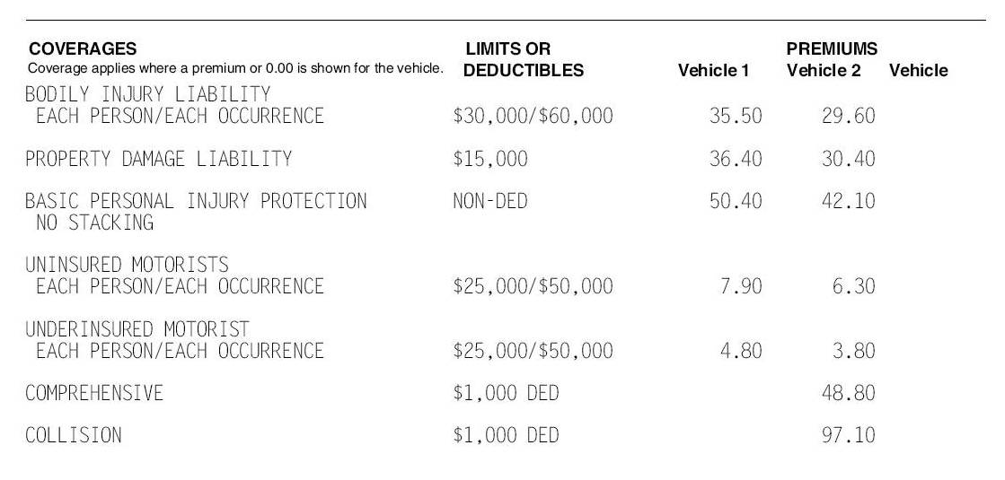
Screening Managerial Ability
Bae, Hwang and Hyun. Empirical Examination on Sorting Effects of Performance Pay. Working paper
US Data reveal that
  Managerial ability is positively associated with pay-performance sensitivity
  The positive association between managerial ability and pay-performance sensitivity is more pronounced when there is greater uncertainty on managerial ability
    SP500 firms, firms size, external vs. internal CEO hires

Slide 15
Matching Incentive with Ability
Banker, Darrough, Huang, and Plehn-Dujowich. 2013. The Relation between CEO Compensation and Past Performance. The Accounting Review
A two-period principal-agent model with moral hazard and adverse selection
y_{τ} (e_{τ} , a_{τ}) = δ_{τ} e_{τ} + λ_{τ} a_{τ} + ε_{τ} , τ = 0, 1
Lemma & Propositions
  For a new agent,
  the optimal Period 0 expected bonus increases with ability (to screen ability).
  the optimal Period 0 salary decreases with ability (to offset information rent).
  For a continuing agent,
  the optimal Period 1 salary is positively associated with y₀ (ability) and y₁.
  the optimal Period 1 expected bonus is negatively associated with y₀ (ability) and positively associated with y₁.

Slide 16
Matching Incentive with Ability
Sera Choi & Iny Hwang

Slide 17
Matching Incentive with Ability
Sera Choi & Iny Hwang

Slide 18
Matching between Incentive and Ability

Slide 19
Matching between Incentive and Ability

Slide 20
Matching between Incentive and Ability

Slide 21
Matching between Incentive and Ability

Slide 22
Analysis (2)
Sera Choi & Iny Hwang

Slide 23
Matching Incentive with Ability
Sera Choi & Iny Hwang
Pay-Performance-Sensitivity (PPS)
  Higher PPS for higher ability
  y_{τ} (e_{τ} , a_{τ}) = δ_{τ} e_{τ} + λ_{τ} a_{τ} + ε_{τ}
  → The same marginal productivity of effort (δ_{τ}) between high and low type managers?
Ability~Incentive Match and CEO Turnover

Slide 24
Non-CEO Executive Ownership and CEO Ability
Sera Choi, Iny Hwang, Kuan-Hui Lee, & Seung-Hee Yang
Why would other executives respond to CEO ability?
Incumbent executives have a better opportunity to assess CEO ability since they can direct observe CEO’s personal traits as well as his decision-making process.
Such private information is likely to affect the executives’ decisions that are associated with future firm performance (e.g., stock ownership).
New CEO ability and other executives’ stock ownership
changes in the executive stock ownership
New CEO
“Speed of learning” matters: If the executives learn about new CEO ability earlier than the investors do, the executives can enjoy greater profits from stock investment.
learning period
subsequent
performance
※ability: including general ability, execution skills, match quality, etc.
learn about the new CEO’s ability

Slide 25
Non-CEO Executive Ownership and CEO Ability
Sera Choi, Iny Hwang, Kuan-Hui Lee, & Seung-Hee Yang
New CEO Ability and the Executive Stock Ownership
A top manager’s stock ownership in the firm signals to the board information about his or her own privately known ability to run the company (Boyer et al. 2008).
If perceived CEO ability is high, the executives may revise expectations about future firm prospects upward and thus may increase their stock ownership.
→ Changes in the executives’ ownership signals their perceptions of new CEO ability.
H1: New CEO ability is positively associated with changes in the executive stock ownership.
Mandatory ownership vs. Voluntary ownership
Mandatory ownership: ownership held based on the compensation package (i.e., stock options and restricted shares)
Voluntary ownership: ownership other than stock options and restricted shares
Voluntary ownership conveys stronger signals about the executives’ perception of CEO ability.
H2: The positive association between new CEO ability and changes in the executive stock ownership is more pronounced fore voluntary ownership than mandatory ownership.

Slide 26
Non-CEO Executive Ownership and CEO Ability
Sera Choi, Iny Hwang, Kuan-Hui Lee, & Seung-Hee Yang
The Executive Stock Ownership and Firm Performance
The evidence on the relationship between managerial stock ownership and firm performance is mixed.
(+): Managerial ownership has a positive impact on firm performance (McConnel and Servaes 1990; McConnel et al. 2008; Lilienfeld-Toal and Ruenzi 2014).
(-): Too high ownership rather deteriorates firm performance (Morck et al. 1988).
Increases in executive stock ownership induced by positive perception of CEO ability are likely to incentivize the executives to engage in more value-increasing activities (↔ purchase of stocks for entrenchment purposes).
H3: Changes in the executive stock ownership are positively associated with subsequent firm performance.
※ Agle et al (2006): Top management team perceptions of CEO charisma has a positive relationship with organizational performance.

Slide 27
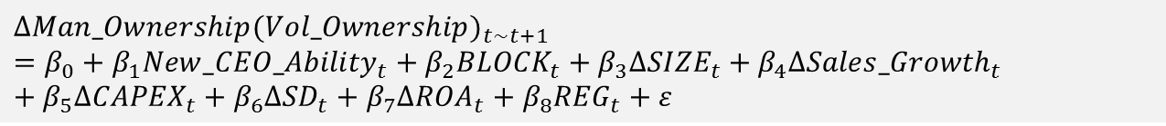
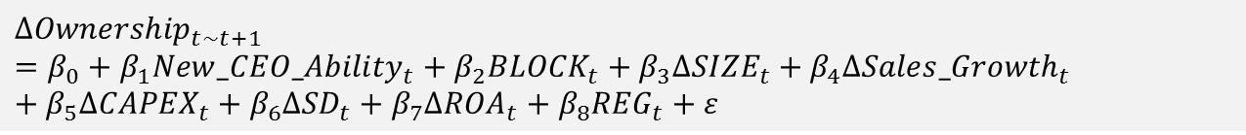
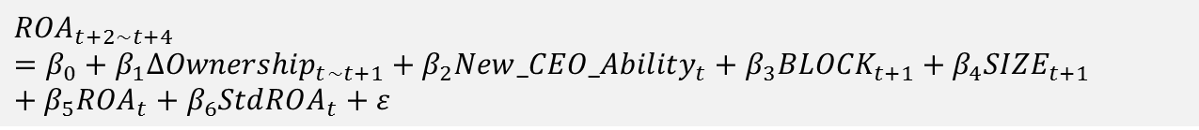
Non-CEO Executive Ownership and CEO Ability
Sera Choi, Iny Hwang, Kuan-Hui Lee, & Seung-Hee Yang
Regression Models
$$∆{Ownership}_{t\sim t+1}=β_{0}+{β_{1}{New_CEO_Ability}_{t}+β}_{2}{BLOCK}_{t}+β_{3}∆{SIZE}_{t}+β_{4}{∆Sales_Growth}_{t}+β_{5}{∆CAPEX}_{t}+β_{6}{∆SD}_{t}+β_{7}{∆ROA}_{t}+β_{8}{REG}_{t}+ε$$
H1: β₁>0
$$∆{Man_Ownership(Vol_Ownership)}_{t\sim t+1}=β_{0}+{β_{1}{New_CEO_Ability}_{t}+β}_{2}{BLOCK}_{t}+β_{3}∆{SIZE}_{t}+β_{4}{∆Sales_Growth}_{t}+β_{5}{∆CAPEX}_{t}+β_{6}{∆SD}_{t}+β_{7}{∆ROA}_{t}+β_{8}{REG}_{t}+ε$$
H2: β_{1, Vol}>β_{1, Man}
BLOCK = indicator variable that equals 1 for blockholder ownership
SIZE = firm size, defined as natural logarithm of total assets
Lev = market leverage, defined as total debt divided by market value of equity
SD = standard deviation of stock returns
ROA = returns on assets
REG = indicator variable that equals 1 for firms in regulated industries
※ year and industry fixed effects included
$${ROA}_{t+2\sim t+4}=β_{0}+{β_{1}∆{Ownership}_{t\sim t+1}+β_{2}{New_CEO_Ability}_{t}+β}_{3}{BLOCK}_{t+1}+β_{4}{SIZE}_{t+1}+β_{5}{ROA}_{t}+β_{6}{StdROA}_{t}+ε$$
H3: β₁>0
StdROA = standard deviation of ROA for three years

Slide 28
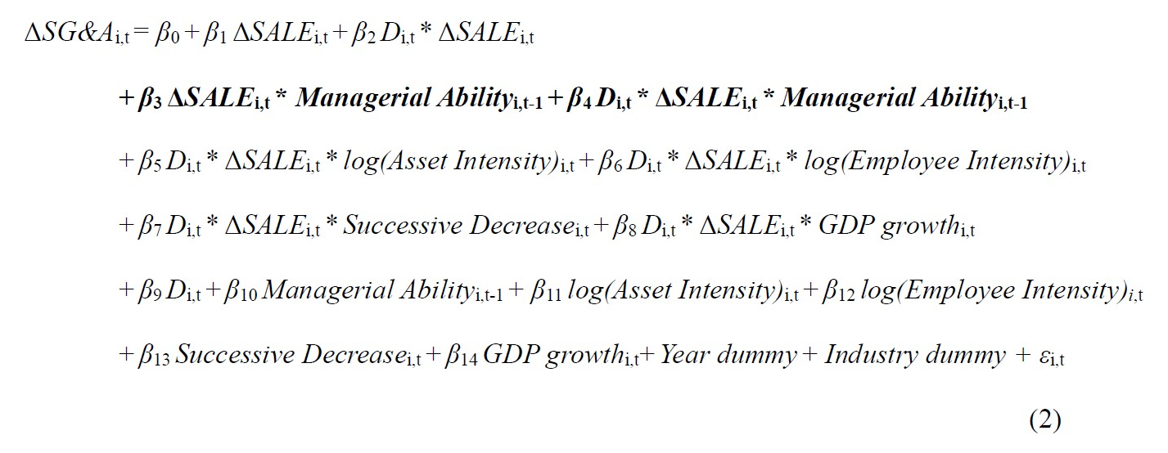
Managerial Ability and Cost Decisions
Sera Choi, Iny Hwang, & Jin-Ha Park (Under review at The Accounting Review)
Hypotheses
  SG&A cost asymmetry is positively associated with managerial ability.
  The positive association between managerial ability and SG&A cost asymmetry is higher when managers have greater discretion.

Slide 29
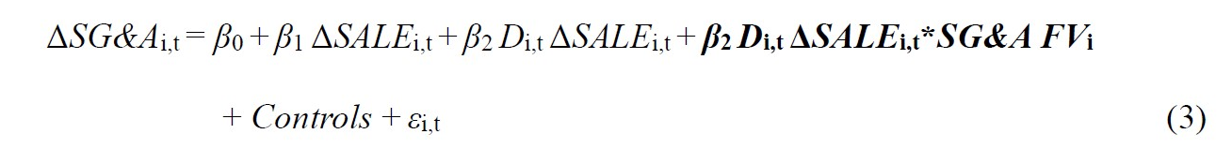
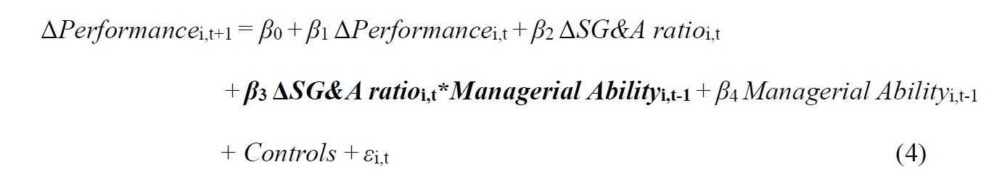
Managerial Ability and Cost Decisions
Sera Choi, Iny Hwang, & Jin-Ha Park (Under review at The Accounting Review)
Supporting Analyses
  Firms with greater SG&A future value are likely to retain slack resources when sales decrease, which applies only to the high type managers.
  The more capable managers are, the greater the returns on SG&A expenditure.

Slide 30

Q & A

